Slide 1
31 – Clean Code – Observer Pattern
Based on the CleanCoders videos by Uncle Bob Martin
Rupert Waldron

Slide 2
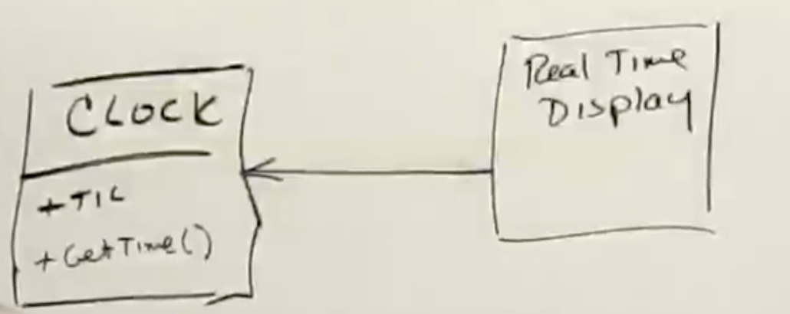
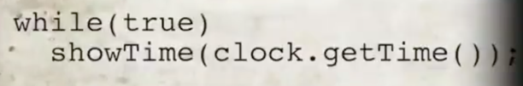
Clock example
Clock object gets a tic from the system every milli-second, we need to display the time using the getTime() method accurate to the second in our app.
Does not leave a lot of processing power for anything else.
Very accurate though.

Slide 3
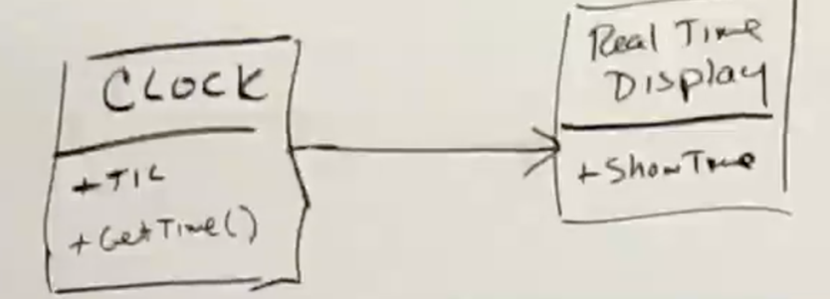
Clock example – attempt 2
How to preserve the accuracy but not waste all the cpu cycles?
Clock calls showTime() method whenever the seconds change – accurate and efficient.
So what is wrong with this?
This violates the single responsibility principle because the Clock shouldn’t know anything about the display.
Every time you make a change to the display you have to recompile the Clock

Slide 4
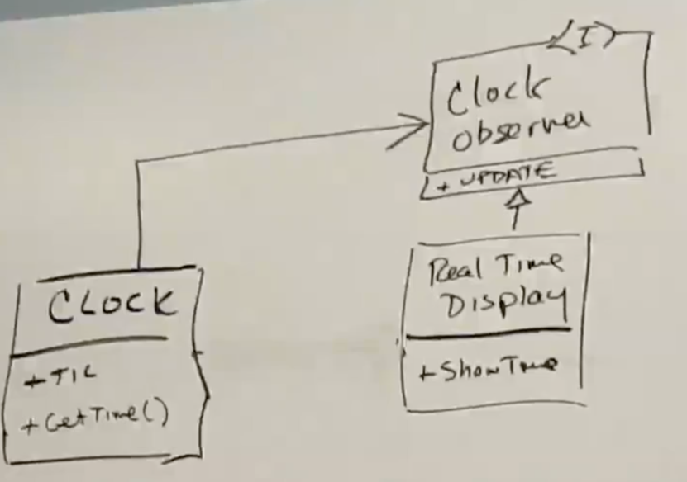
Clock example – attempt 3
Lets look back to our Solid principles and use dependency inversion
Clock contains the ClockObserver Interface and will invoke the update() when the seconds change.
The RealTimeDisplay will implement the update()
How does the Clock find out about the RealTimeDisplay?

Slide 5
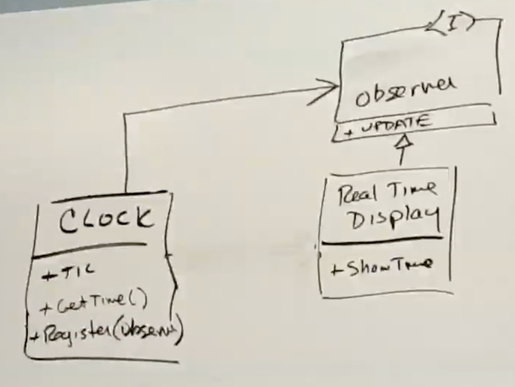
Clock example – attempt 4
Add a register(Observer ob) method to the Clock
Note Clock is now missing
Main() would call the register(Observer ob) method to register the RealTimeDisplay with the clock
How does the Clock find out about the RealTimeDisplay?

Slide 6
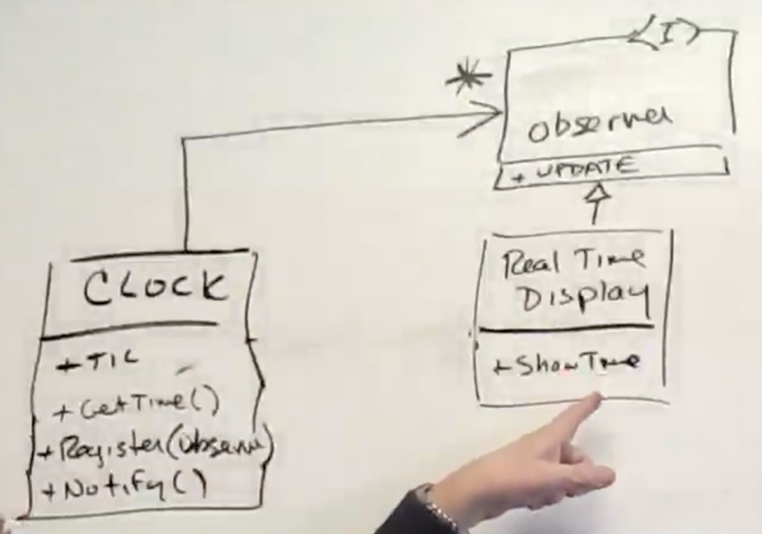
Clock example – attempt 5
Can we add more than one observer?
Add a notify() method to Clock which will then loop through all the observers calling update() on each one
This violates the SRP for Clock again as clock shouldn’t know about register(Observer) or notify(). Could try to inherit those methods instead…

Slide 7
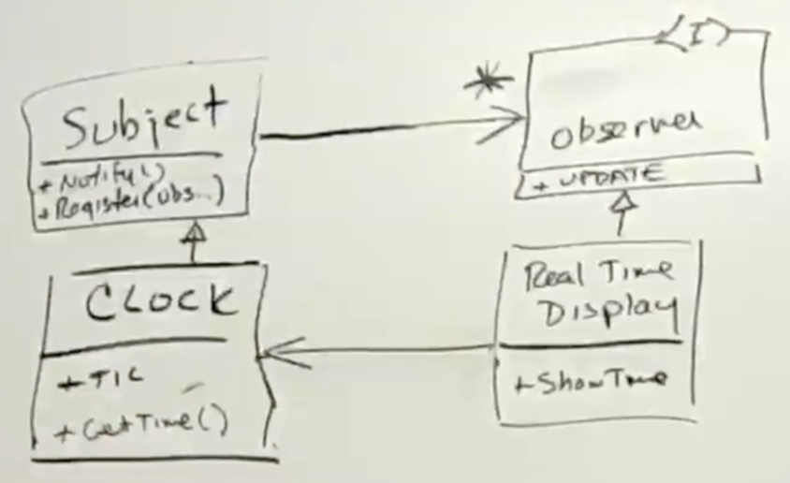

Clock example – attempt 6
Create the abstract Subject class which has the notify() and register() methods. Subject class also maintains the list of observers.
The Real Time Display must call the Clock getTime() method
However, this doesn’t do much because inheritance is the strongest of couplings. Clock still has all the methods and instance variables. How about with multiple inheritance?

Slide 8
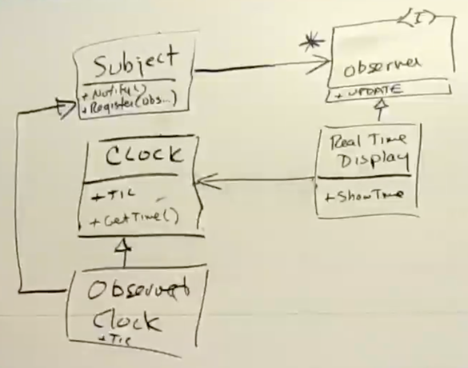
Clock example – attempt 7
Multiply inherit from Subject and Clock to create Observable Clock.
Can do this in Java or C#
However, this doesn’t do much because inheritance is the strongest of couplings. Clock still has all the methods and instance variables. How about with multiple inheritance?

Slide 9
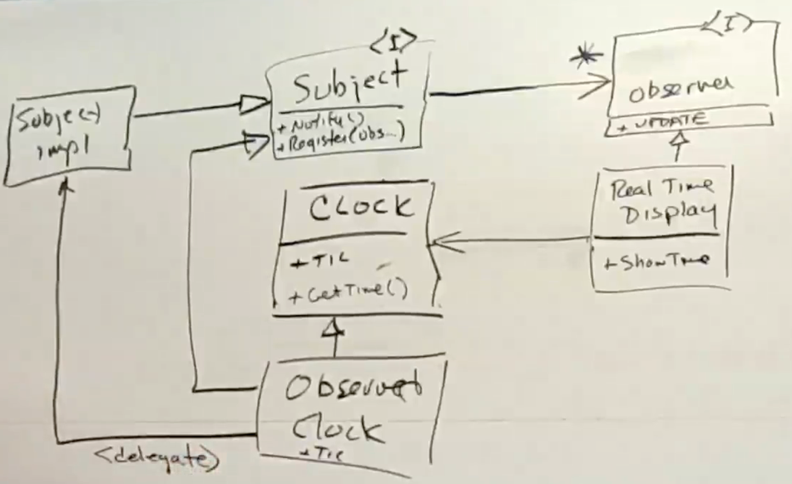
Clock example – attempt 8
This is the version that doesn’t violate the Single Responsibility Principle
ObservableClock Derives from Clock
ObservableClock delegates to SubjectImpl which derives from Subject interface
SubjectImpl implements the notify() and register() methods
When tic() is called on Clock, ObservableClock will call tic() which then delegates to SubjectImpl to call notify() on all the observers.
The notify() method calls update() on each observer. The update() will call showTime() method in the RealTimeDisplay which then will call getTime() on the clock instance.

Slide 10
Clock example – Gof Book Example – Pull Observer
Gof didn’t worry about the Clock knowing too much about the observers
The Observer Pattern is used when you have an object that can change for various reasons and you’d like to be notified of those changes
In this design showtime() in RealTimeDisplay calls the getTime() method on the clock instance inside RealTimeDisplay.
Hence RealTimeDisplay will pull the information from the clock – The Pull Observer
In this design the Observer and Subject classes no nothing about the data that is being exchanged so can be reused across all other pull model observers

Slide 11
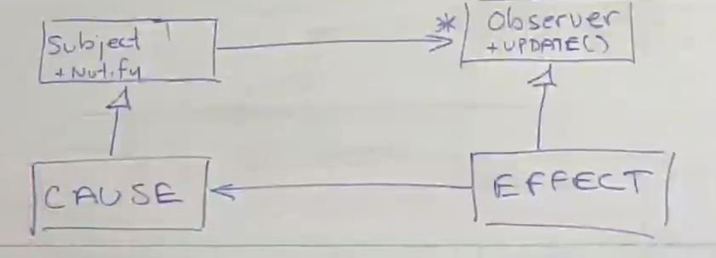
Pull Observer
If the subject is responsible for a lot of data then how would the observer know which data had changed when update() was called?
The Pull Observer is a way to invert the dependencies between cause and effect.
The Effect is passive because it is waiting for the Cause to tell it something has happened. Yet the Effect depends upon the Cause.

Slide 12
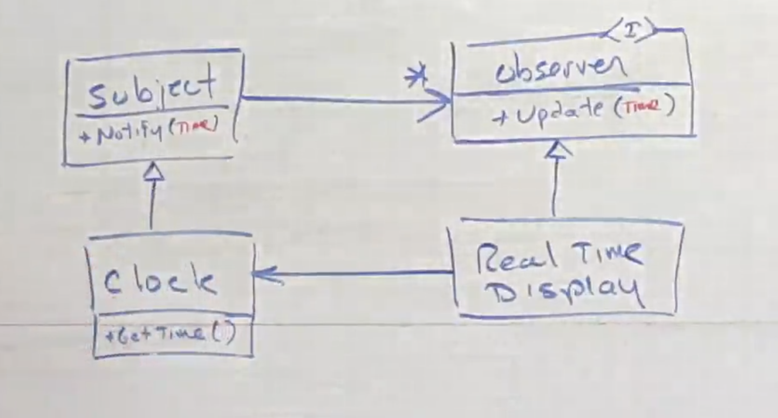

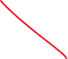
Push Observer – Passing a hint
If we pass the time as an argument then there is no need for the RealTimeDisplay to ask the Clock for the time.
In the Pull Observer the Subject and Observer must know about the type of data being pushed – just pass Object?
Not Generics again???

Slide 13
To Push or Pull?
Pull
When the data is small
When the data is complicated – don’t want to push all that data
When the data is time critical – it might take some time to push the data
Push
When the data is small
If the data is complicated you might need a hint

